Slide 1
BUSINESS PLAN ON ICE BLOCK MAKING MACHINE.
Presented
By
De Koolar Nigeria Limited
14 Hakeem Balogun Street, Agidingbi Ikeja, Lagos.
Tel: 01-2957035, 08033309537
Email: info@dekoolar.com
Website: www.dekoolar.com

Slide 2
Become an instant millionaire from ice block making.
Introduction
Have you given thought to those business opportunities that will thrive irrespective of economic recession or boom? One of such businesses is ice block making. It is a business that people tend to look down on, but it is a very lucrative business, especially when operated on a large scale. Research has revealed that one can make between N250, 000 to N300, 000 profits monthly. It is a business that returns on investment (ROI) is highly guaranteed. That means you can make your investment back in no time in ice block making and supply especially during the dry season. Ice block is water in its solid state. It is produced when water is fed into some nylon bags and then packed into an Ice block making machine for some hours to solidify.
The high demand for ice blocks for cooling has created a booming business opportunity in cities, towns and villages across Nigeria. We live in a very hot environment and so we consume lots of liquid/drinks. Except on medical grounds, every Nigerian would prefer cold drinks to warm drinks any time, any day. People who run businesses that deal on drinks will attest to the fact that customers will always demand for chilled drinks and when you can give them chilled drinks at every point, then you will be their first port of call as long as drinks is concerned.

Slide 3
Sales forecast
Quantity | Unit price (N) | Daily income (N) | Monthly income (N) | Yearly income (N)
300 | 100 | 30,000 | 900,000 | 10,800,000
300 | 150 | 45,000 | 1,350,000 | 16,200,000
300 | 200 | 60,000 | 1,800,000 | 21,600,000
300 | 250 | 75,000 | 2,250,000 | 27,000,000
300 | 300 | 90,000 | 2,700,000 | 32,400,000

Slide 4
The ice block business is indispensable due to the following reasons
Country like Nigeria is located in one of the hottest region in the world
The need for ice block in poultry cannot be over emphasizes i.e. the need for cold drink to drop the temperature of water being drank by the chicken for healthy living and egg production.
Most of the commercial cities always experience heavy traffic couple with hot weather which make people yearn for cold and chilled drinks, beverages, snacks and so on regularly.
Baking and event centers use quite numbers of ice block for the mixing of flour and chilling of drinks respectively.
One can imagine the number of chilled sachet water people drink every day.
Ice block is needed in hospital and medical environment for cooling of some medical equipment where air conditioners are not used.
Another convenient reason why people prefer to use ice blocks is that they are faster and more efficient at cooling liquid. Compared to cooling your drinks in a fridge or packing them in a freezer when you can’t carry your iced drinks from home everywhere, ice blocks can provide chilled liquid in any location; whenever and wherever you want it.

Slide 5
Procedure and equipment needed for ice making business
Location: you can start from home or rent a shop. Ice block is more convenient to produce from home, but if it’s on a large scale you will need a bigger space.
Ice block making machines and Deep freezers
Generator that can conveniently power your machine and deep freezers.
A good water source. Water is very important in Ice block making business so, you will need to either sink a water bore hole or buy water from commercial water tankers in your area.
Nylon bag for molding ice block. When sourcing for nylon, you need to order correctly because there is a nylon specially made for Ice block packaging.

Slide 6
Target market
Beer Parlours or Drink sellers;
Party hosts – people organizing parties;
Restaurant and fast foods;
Roadside Hawkers;
Poultry farms;
Baking industries;
Sport arena;
Some manufacturing companies;
Fishery industries;
Drug manufactures and pharmaceutical companies also need the ice block for cooling effect of their drugs and vaccines.

Slide 7
Funding
The capital required to start an ice block production business in Nigeria depends on the quantity of ice block you intend to produce per day. You can start with 50 blocks ice making machine which is less expensive. But if you want to generate say N300, 000 per month, then you need about 3-5 million Naira and above as capital to purchase your Ice block making machines and other equipment needed. Visit www.dekoolar.com for various prices. The above figure does not include the cost of renting a factory space or the building to install your machines as the cost of renting accommodation differs from one location to the other.

Slide 8
Equipment Required
Ice block making Machine
Deep freezer
Delivery van (optional)
Alternative power source; Generator.
Choice of packaging finished products.

Slide 9
Production Process
Clean the machine for ice block placement.
Fill nylon with borehole water.
Tighten the nylon after filling.
Arrange in the machine.
Remove after 12 hours
Arrange in the freezer to prevent it from defrosting.
Rearrange another set in the machine for production.
Ice block are ready for sale to retailers and institution buyers.

Slide 10
Daily production
Daily production | 12 hours | 150
Daily frequency | Twice daily | 2
output | Daily | 300
Cost of production
Nylon cost | N 2 per block | N 600
Cost of fuel | N 7,680 | N 15,360
Salary | N 3 per block | N 900

Slide 11
Selling price (monthly)
Product (300 pieces) | Ice block | 300
Unit price | One | N 150
Daily sales | 300 pieces x 150 naira | N 45,000
Monthly sales | 45,000 daily x 30 days | N 1,350,000

Slide 12
Expenses (monthly)
Nylon cost | 9,000 pieces X 2 | N 18,000
Salary | 900 X 30 | N 27,000
Cost of fuel | 15,360 daily X 30 days | N 460,800
Month depreciation | 10% depreciation yearly / 12 month | N 24,167
Total expenses |  | N 529,967

Slide 13
Selling and Expenses (Yearly)
Product (108,000 pieces) | Ice block | 108, 000
Unit price | one | N 150
Yearly sales | 108,000 X 150 naira | N 16,200,000
 | Yearly expenses
Nylon cost | 108, 000 pieces X 2 | N 216,000
Salary | 108,000 pieces X 3 | N 324,000
Cost of fuel | 460,800 monthly X 12 | N 5, 529,600
Yearly depreciation | 10% depreciation yearly | N 290,000
Total expenses |  | N 6,359,600

Slide 14
Equipment set-up cost
 | 24 Blocks | 50 Blocks | 100 Blocks | 150 Blocks | 200 Blocks | 300 Blocks | 500 Blocks
Machine cost | 1,800,000 | 980,000 | 1,850,000 | 2,900,000 | 3,900,000 | 5,750,000 | 8,500,000
Storage tank | 80,000 | 80,000 | 80,000 | 80,000 | 80,000 | 80,000 | 80,000
Freezer required | 1 | 1 | 1 | 2 | 2 | 3 | 3
Freezer cost | 150,000 | 150,000 | 150,000 | 300,000 | 300,000 | 450,000 | 450.000
Generator | 2,150,000 | 1,950,000 | 2,150,000 | 2,410,000 | 2,410,000 | 3,400,000 | 3,550,000
Total | 4,180,000 | 3,160,000 | 4,230,000 | 5,690,000 | 6,690,000 | 9,680,000 | 12,580,000

Slide 15
De Koolar Nig. Ltd. Machine price list
Hours 2 | Cost | Recommend Generator size
24 blocks | N 1,800,000 | 20KVA
8 Hours
50 Blocks | N 1,200,000 | 12.5KVA
100 Blocks | N 2,500,000 | 20KVA
150 Blocks | N 3,680,000 | 30KVA
200 Blocks | N 4,800,000 | 45KVA
300 Blocks | N 6,150,000 | 60KVA
500 Blocks | N 10,400,000 | 100KVA
12 Hours
50 Blocks | N 980,000 | 12.5KVA
100 Blocks | N 1,850,000 | 20KVA
150 Blocks | N 2,900,000 | 27KVA
200 Blocks | N 3,900,000 | 30KVA
300 Blocks | N 5,750,000 | 40KVA
500 Blocks | N 8,500,000 | 60KVA

Slide 16
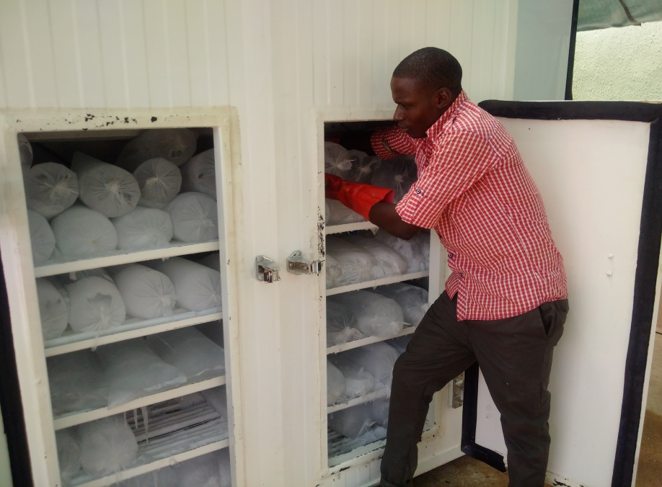
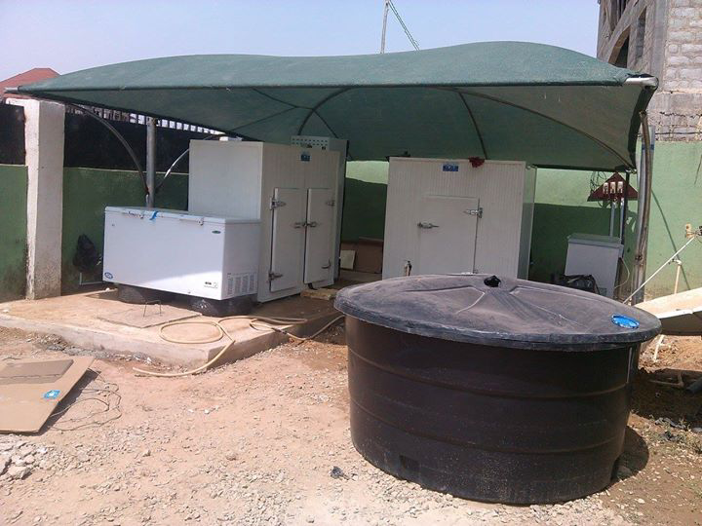
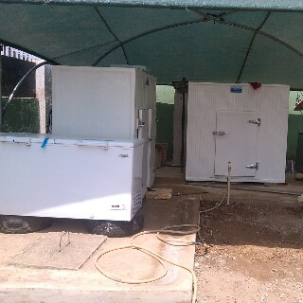
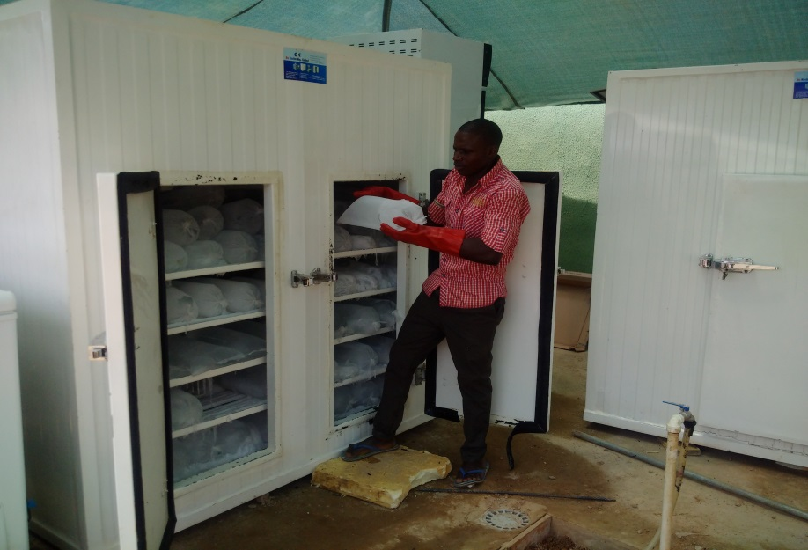
Set –up sample

Slide 17
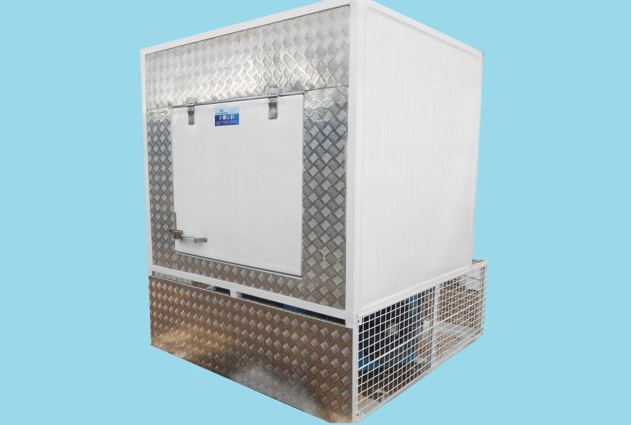
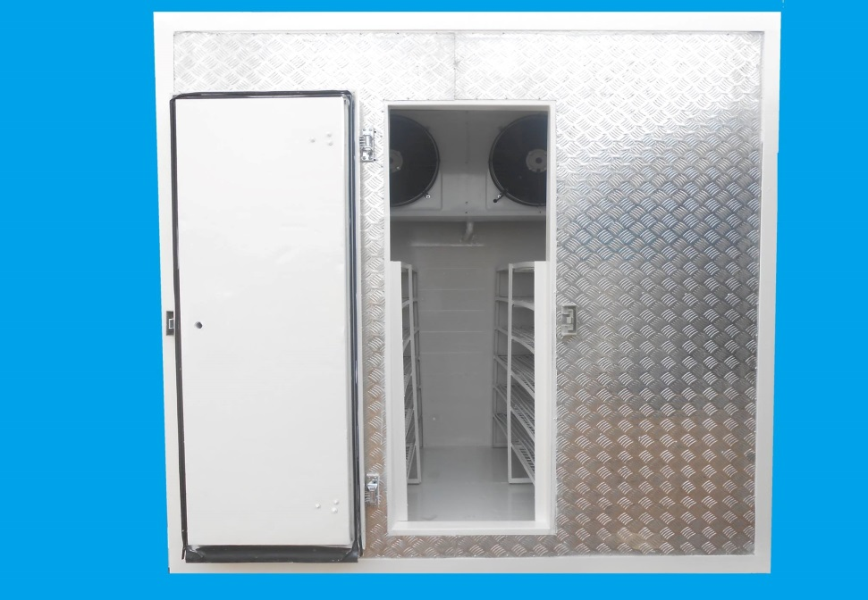
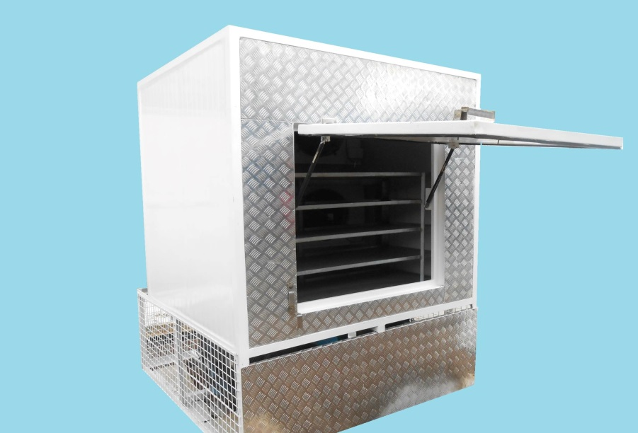
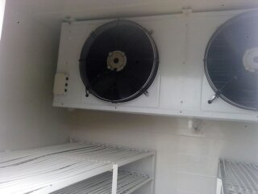
Picture gallery

Slide 18
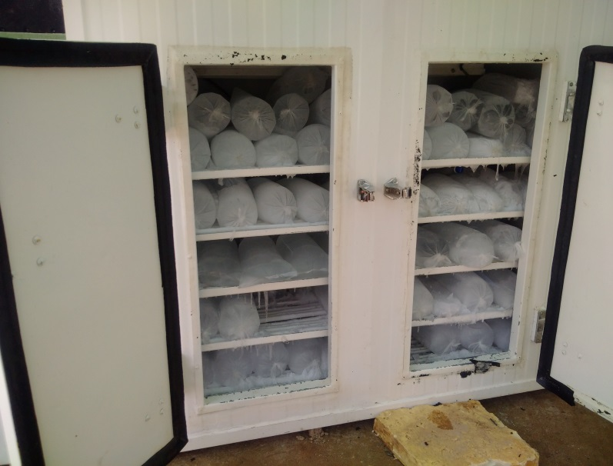
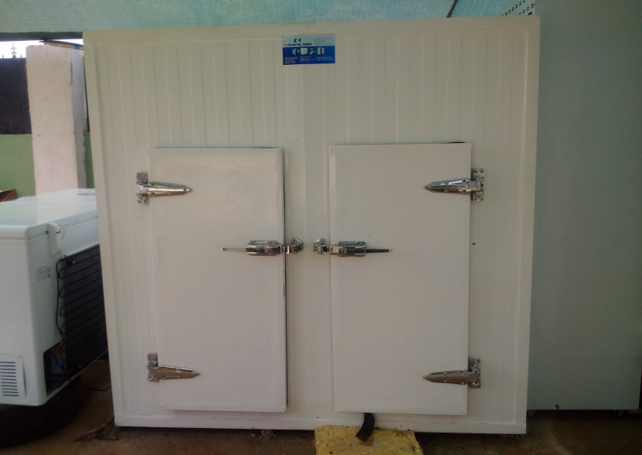
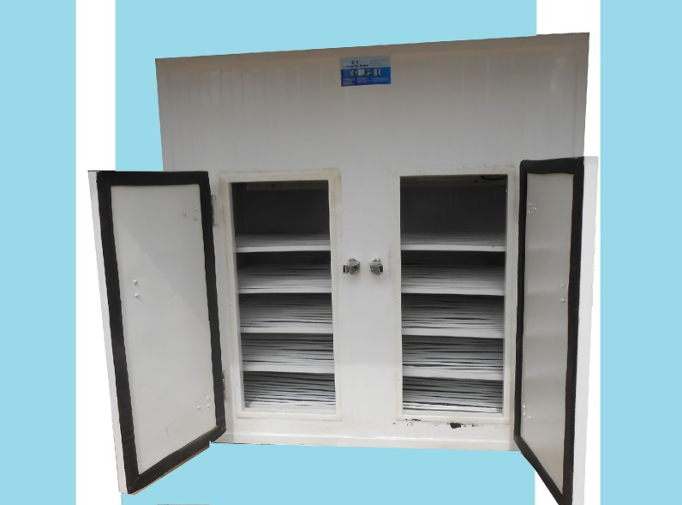
Picture gallery

Slide 19


